Slide 1
ISSUES
POACHING
SEARCH & RESCUE
INJURY
UNSAFE HABITAT
ACCIDENT
Notes:
Nur

Slide 2
EYE OF MORDOR
SPARKTECH
MIGUEL RODRIGUEZ
VINCEN OBIGWE
SHAO WEN-CHANG
ASADUJAMAN NUR
Notes:
Nur

Slide 3
PREVIEW
EYE OF MORDOR
Use Case
Concept Description
Technologies
Implementation
Conclusion
Notes:
Nur

Slide 4
USECASE
EYE OF MORDOR
Drone Surveillance
Collect Data
Get Alert
Rescue
Relocate
Notes:
Nur

Slide 5
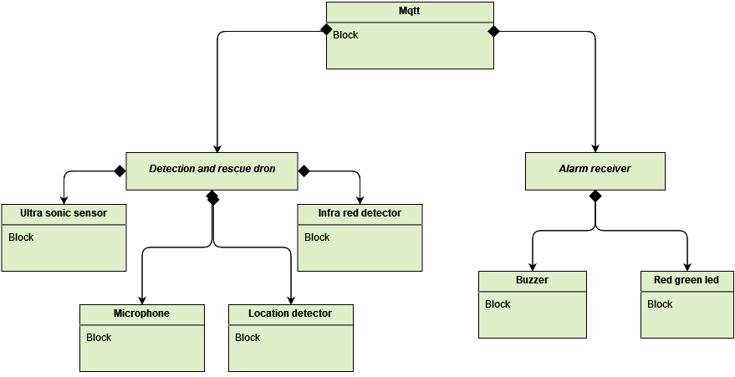
CONCEPT DESCRIPTION
EYE OF MORDOR
Notes:
Concept description – Wen

Slide 6
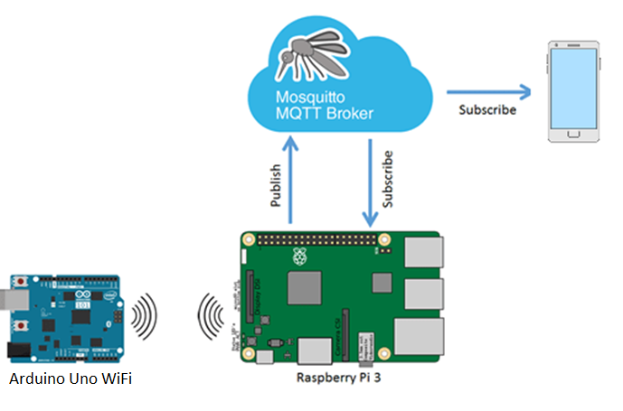
WIRELESS INTERCONNECTIVITY
EYE OF MORDOR
Notes:
wen

Slide 7
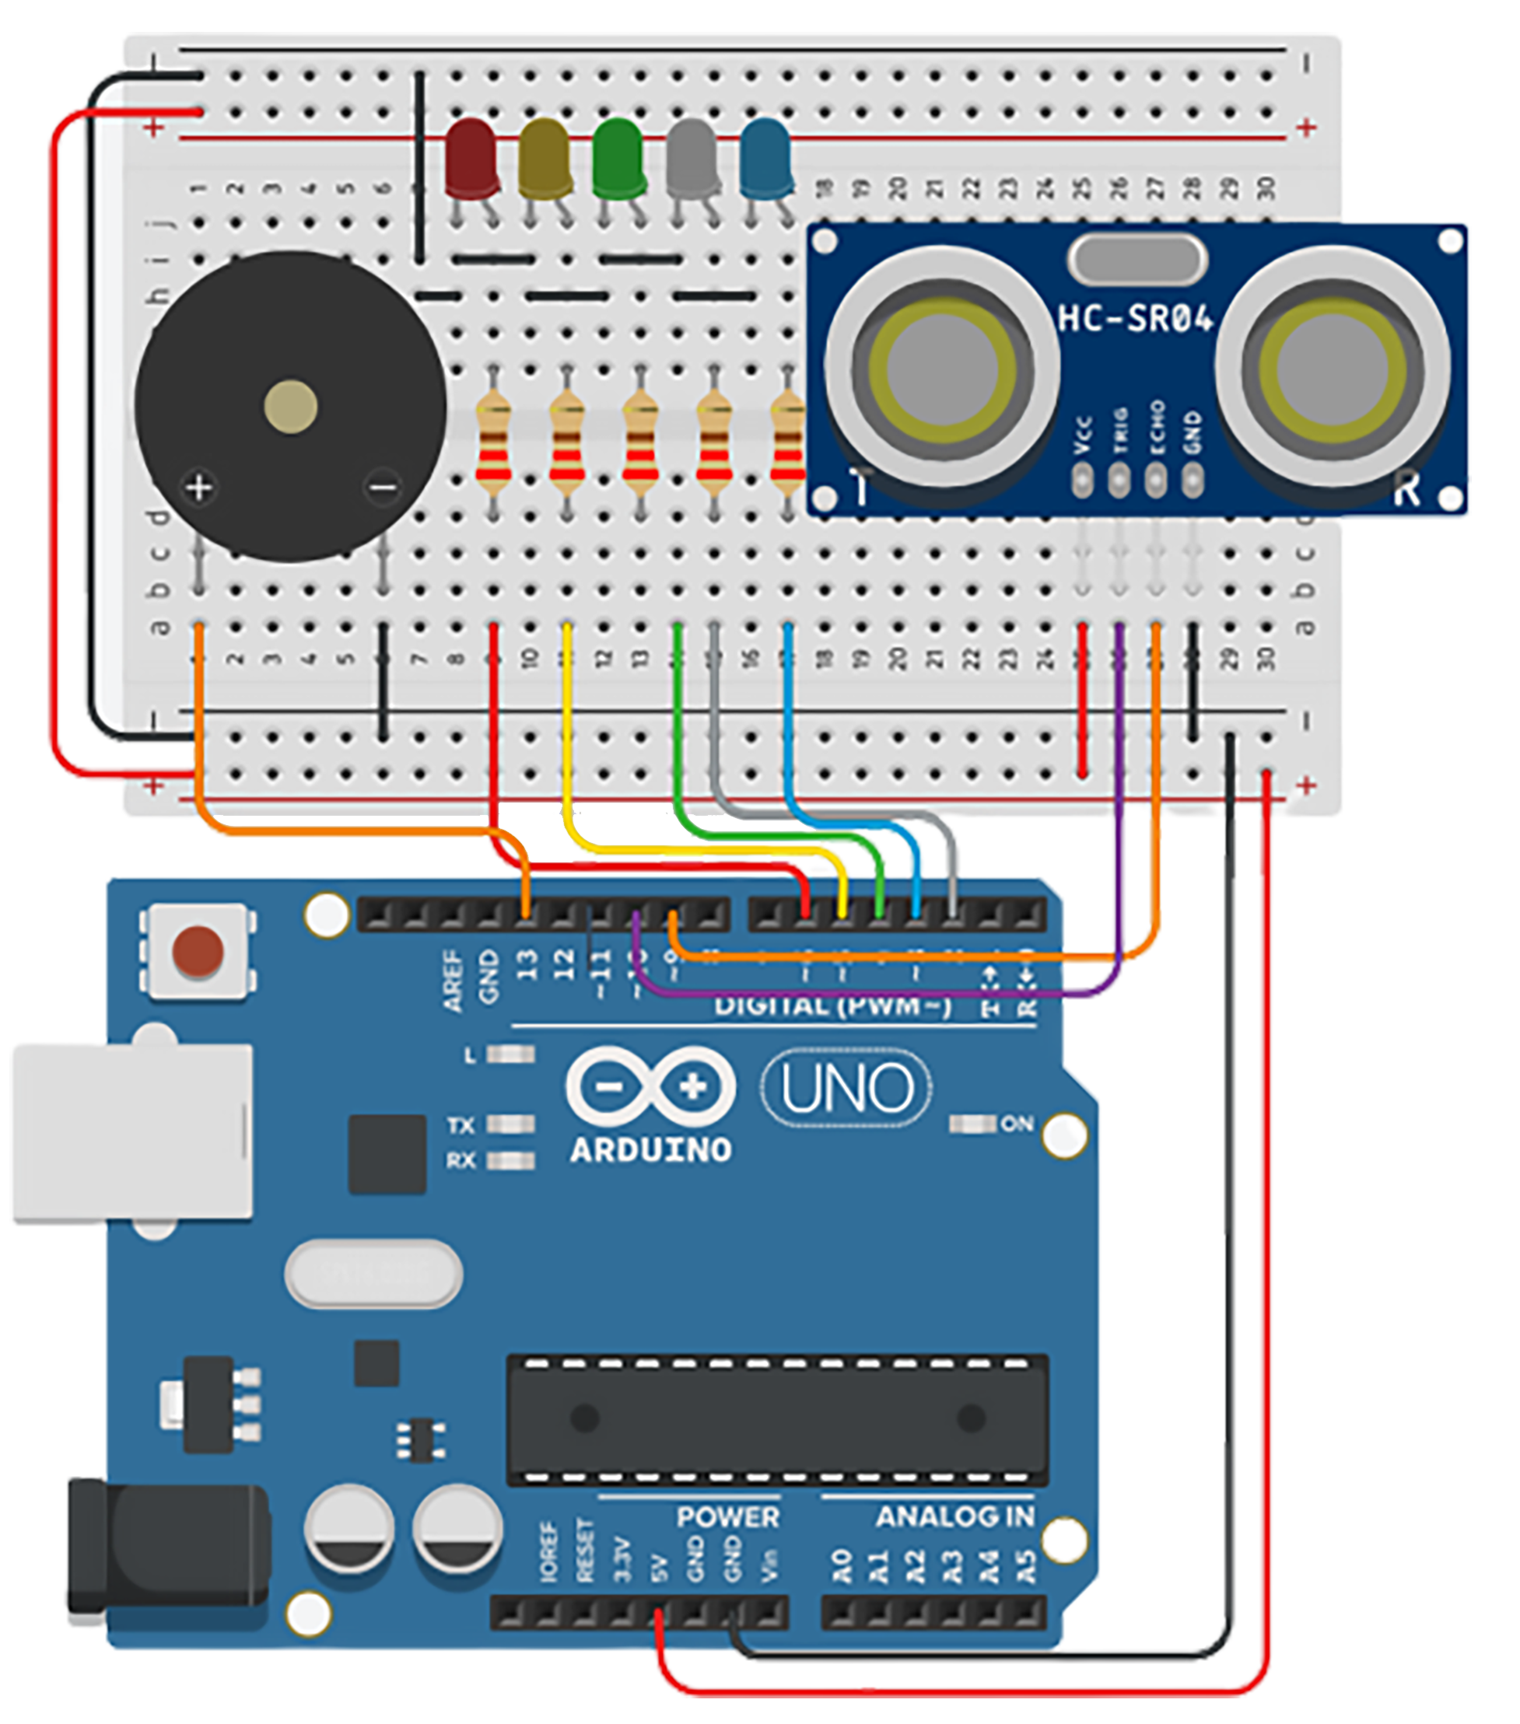
SIMULATION CONNECTIVITY
PROTOTYPE
Notes:
wen

Slide 8
EYE OF MORDOR
TECHNOLOGY
HARDWARE
SOFTWARE
Notes:
vincent

Slide 9
HARDWARE
TECHNOLOGY
PHONE
SENSORS
ARDUINO
RUSPBERRY PI
BUZZER
BREADBOARD
LED
Notes:
vincent

Slide 10
SOFTWARE
TECHNOLOGY
Mosquitto
IOT Panel App
MQTT
Notes:
vincent

Slide 11
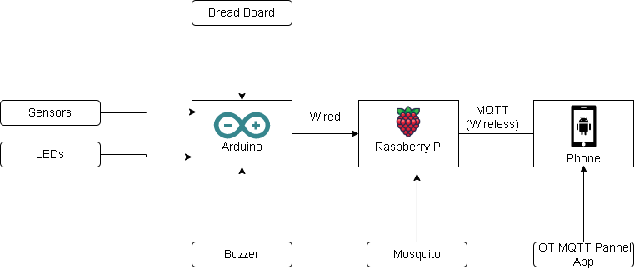
TECHNOLOGY
EYE OF MORDOR
Notes:
vincent

Slide 12
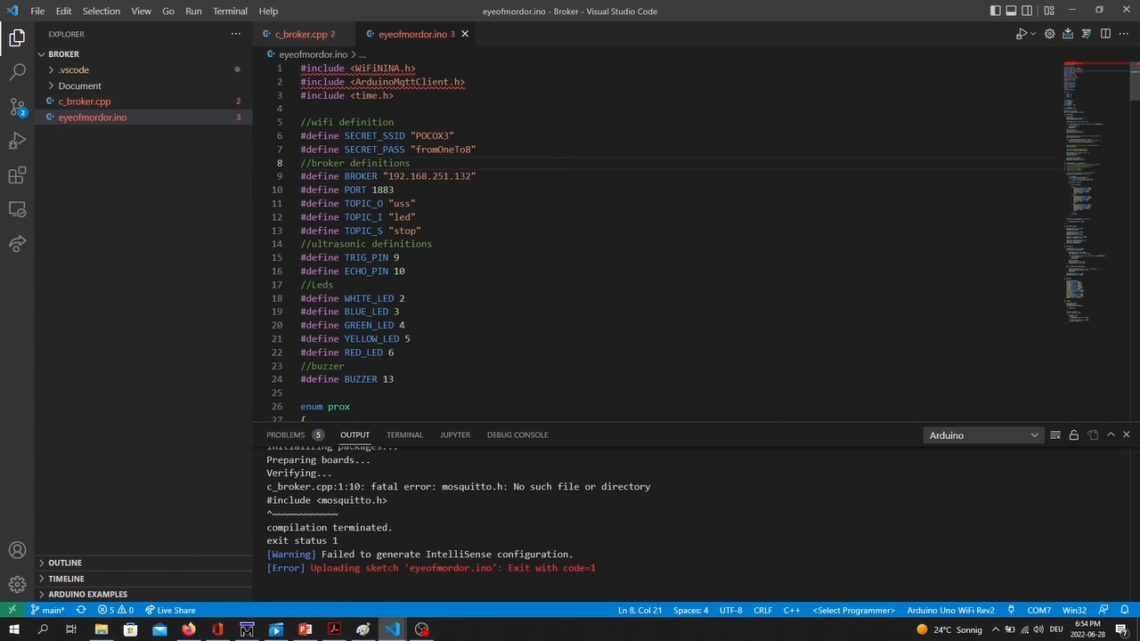
IMPLEMENTATION
EYE OF MORDOR
Notes:
Miguel

Slide 13
EYE OF MORDOR
CONCLUSION
Animal protection is very important
So many species of animals are endangered due to carelessness by man.
The solution also serves a protection for farmer.
Usecase can be extended or switched using the same technology and approach.
Notes:
Vincent

